Slide 1
Efficient Password Mechanism to Overcome Spyware Attacks
GUIDE:
Mrs.Sangeetha Krishnan,
Asst.professor,
CSE department.
TEAM MEMBERS:
Nivethitha.R(211417104174)
Varsha.M(211417104291)

Slide 2
ABSTRACT:
This work enhances traditional authentication systems based on Personal Identification Numbers (PIN) and One Time Passwords (OTP) through the incorporation of biometric information as a second level of user authentication. In our proposed approach, users draw each digit of the password on the touchscreen of the device instead of typing them as usual.A complete analysis of our proposed biometric system is carried out regarding the discriminative power of each handwritten digit and the robustness when increasing the length of the password and the number of enrolment samples. The new e-BioDigit database, which comprises on-line handwritten digits from 0 to 9, has been acquired using the finger as input on a mobile device. This database is used in the experiments reported in this work and it is available together with benchmark results in GitHub 1 . Finally, we discuss specific details for the deployment of our proposed approach on current PIN and OTP systems, achieving results with Equal Error Rates (EERs) ca. 4.0% when the attacker knows the password.These results encourage the deployment of our proposed approach in comparison to traditional PIN and OTP systems where the attack would have 100% success rate under the same impostor scenario.

Slide 3
LITERATURE REVIEW:
YEAR | TITLE | AUTHOR | DESCRIPTION | ADVANTAGE | LIMITATIONS
2014 | “Online Signature Verification on Mobile Devices” | N.Sae-Bae and N. Memon | This paper investigates multitouch gestures for user authentication on touch sensitive devices. A canonical set of 22 multitouch gestures was defined using characteristics of hand and finger movement. Then, a multitouch gesture matching algorithm robust to orientation and translation was developed. Two different studies were performed to evaluate the concept. | It is noticed that performing a user-defined gesture over a customized background image does result in higher verification performance. | In terms of memorability, the study showed that it is feasible for a user to recall user-defined gestural passwords and it is observed that the recall rate increases over time.

Slide 4
YEAR | TITLE | AUTHOR | DESCRIPTION | ADVANTAGE | LIMITATIONS
2015 | “User Verification Using Safe Handwritten Passwords on Smartphones” | T. Kutzner, F.Ye, I.Bonninger, C. Travieso, M. Dutta, and A. Singh, | In this work, in an attempt to become the first research-embedded approach to smartphone vein identification, a novel wrist vascular biometric recognition is designed, implemented, and tested on the Xiaomi© Pocophone F1 and the Xiaomi© Mi 8 devices. | In this paper, a novel contactless vascular biometric recog- nition system for wrist vein modality has been created, tested, and completely embedded into a smartphone. The non-contact interaction with the smartphone, intended for screen unlocking and more secure online payments, has been the motivation behind this work. | Less accuracy rate.Unfortunately, in order to compare the three biometric modalities into a smartphone, as far as is known, these values are not available for the devices used.

Slide 5
YEAR | TITLE | AUTHOR | DESCRIPTION | ADVANTAGE | LIMITATIONS
2016 | “Graphical Password based User Authentication with Free-Form Doodles” | M.Martinez-Diaz, J. Fierrez, and J. Galbally | In this work, authentication with free-form sketches is studied. Veriﬁcation systems using dynamic time warping and Gaussian mixture models are proposed, based on dynamic signature veriﬁcation ap- proaches. The most discriminant features are studied using the sequential forward ﬂoating selection algorithm. | The best performing systems against random and skilled forgeries were tuned for each scenario respectively, and fusion of both systems provided an overall good performance in both scenarios. In our case, score fusion also provides better results than individual systems. | Session intervariability negatively impacts in veriﬁcation per- formance, as already observed , probably due to users that fail to reproduce correctly their own graphical passwords.

Slide 6
YEAR | TITLE | AUTHOR | DESCRIPTION | ADVANTAGE | LIMITATIONS
2020 | “BioTouchPass: Handwritten Passwords for Touchscreen Biometrics” | Ruben Tolosana, Ruben Vera-Rodriguez, Member, IEEE, and Julian Fierrez, Member, IEEE | This work enhances traditional authentication systems based on Personal Identification Numbers (PIN) and One Time Passwords (OTP) through the incorporation of biometric information as a second level of user authentication. In our proposed approach, users draw each digit of the password on the touchscreen of the device instead of typing them as usual | Our proposed approach achieves good results with EERs ca. 4.0% when considering imitation attacks, outperforming other traditional biometric verification traits such as the handwritten signature or graphical passwords on similar mobile scenarios. Additionally, we discuss specific details for the deployment or our proposed approach on current PIN- and OTP-based authentication systems. | Unable to consider lower- and upper case letters and also to train more complex deep learning architectures.

Slide 7
TECHNOLOGY STACK:
Core java
Android
PHP
ALGORITHM:
OCR(Optical Character Recognition) converts the Handwritten character into an machine encoded text .

Slide 8
Software Requirements:
Windows 7 and above
JDK 1.7
Apache Tomcat
Android Studio 3.4
Android Phone

Slide 9
Hardware Requirements:
Hard Disk : 500GB and Above
RAM : 4GB and Above
Processor : I3 and Above

Slide 10
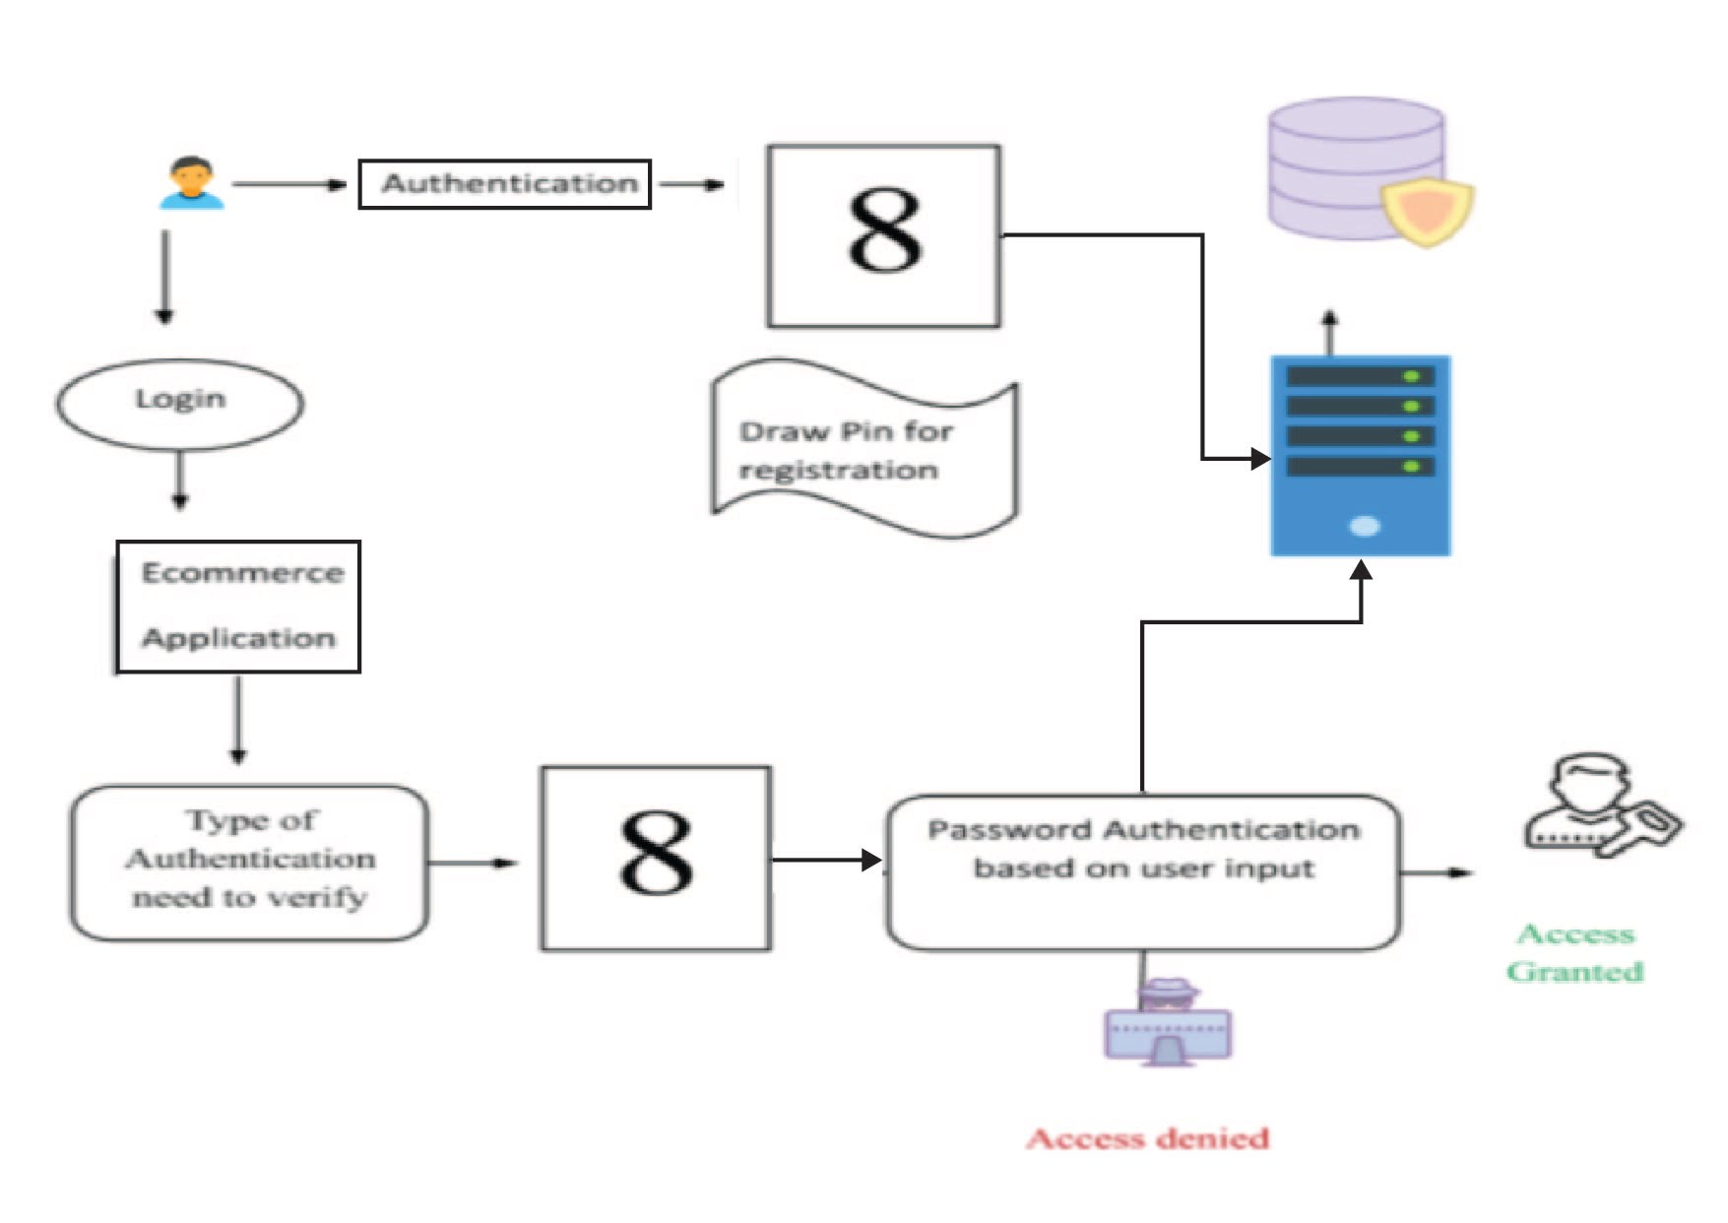
ARCHITECTURE DIAGRAM:

Slide 11
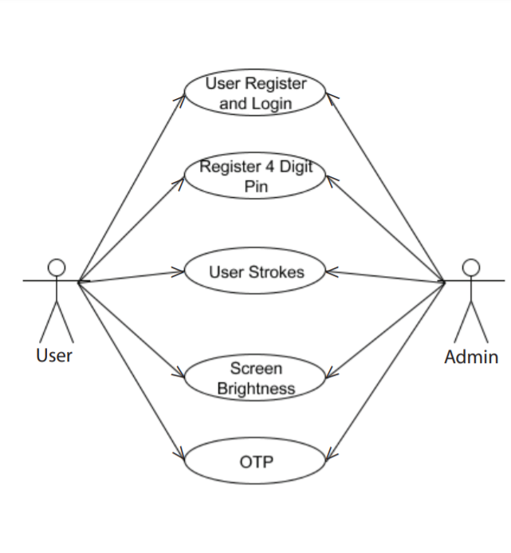
USE CASE DIAGRAM:

Slide 12
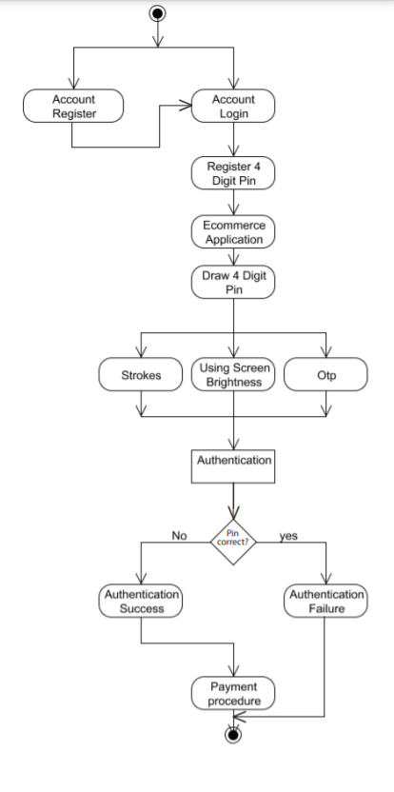
ACTIVITY DIAGRAM:

Slide 13
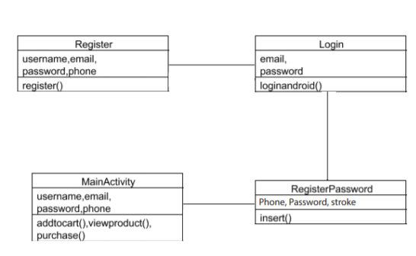
CLASS DIAGRAM:

Slide 14
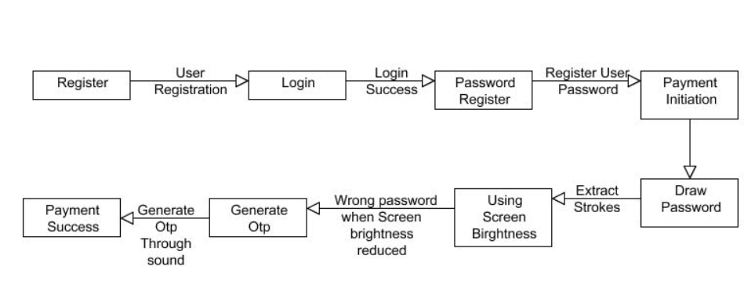
COLLABORATION DIAGRAM:

Slide 15
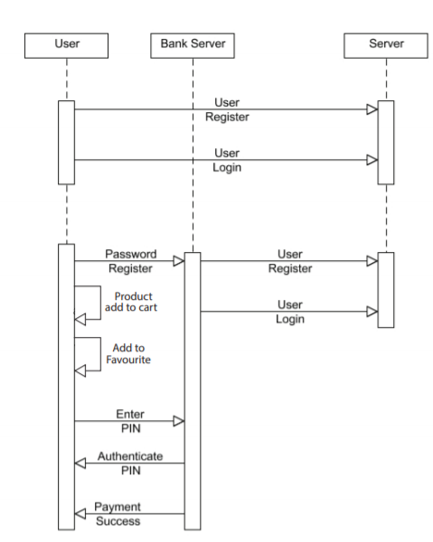
SEQUENCE DIAGRAM:

Slide 16
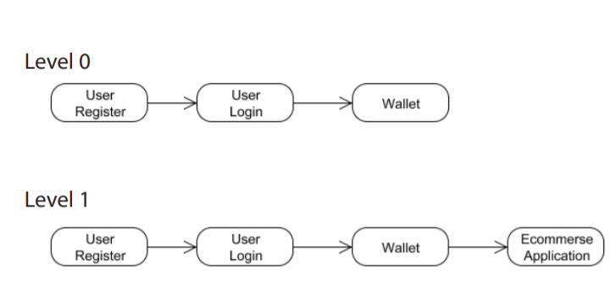
DATAFLOW DIAGRAM:

Slide 17
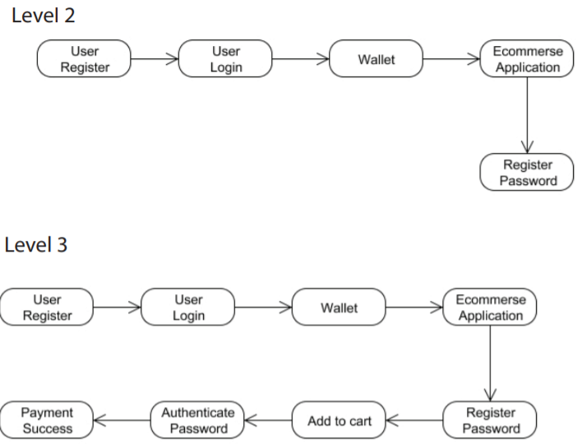

Slide 18
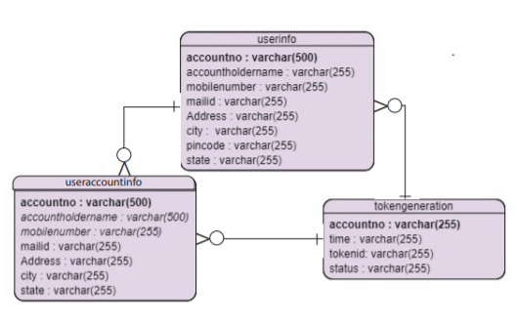
ER DIAGRAM:

Slide 19
MODULES:
MODULE 1:User Registration
MODULE 2:Password Creation Using Strokes
MODULE 3: Product Selection and Payment Using Handwritten Password
MODULE 4: Password Analysing

Slide 20
Modules Description

Slide 21
User Registration
User has an initial level Registration Process. The users provide their own personal information for this process. The server in turn stores the information in its database and user can view a list of products in their page multiple list of products and their details.

Slide 22
Password Creation Using Strokes
User has to register their four digit password with multiple strokes during their registration process once the process completed during confirm password .User has to confirm their password with same password with stroke has to be verified. Strokes for each drawn digits should match with strokes given at time of registration

Slide 23
Product Selection & Payment Using Hand Written Password
User can select a list of product they wish to purchase the selected product will be listed in a cart page and user can initiate general purchase information has to be filled. Completing general detail user has to draw their four digit pin one by one on screen. The drawn password then converted into an image through optical character recognition numbers from each image fetched and verified with user password

Slide 24
Password Analysing
Spyware attack will be avoided by proposing the idea that uses the screen brightness as an authentication tool. The android secure environment generates the 6 digit binary value. Based on the binary digit the brightness of the screen gets changed to high or low. If the screen brightness is high the user should input the correct PIN digit. Else the user should give the wrong and random PIN number. The system will remove the digits which inserted while the screen brightness is low and apply the HMac algorithm for the PIN given by user and generate the Signature for the user PIN which is a digestible Value in order to avoid MAN-IN-MIDDLE attack. The server gets the signature of user generated PIN and generates the signature value for the Original PIN and compare two signatures. If the two Signatures are equal the user can access the Profile of the user. If not user can’t access the profile.

Slide 25
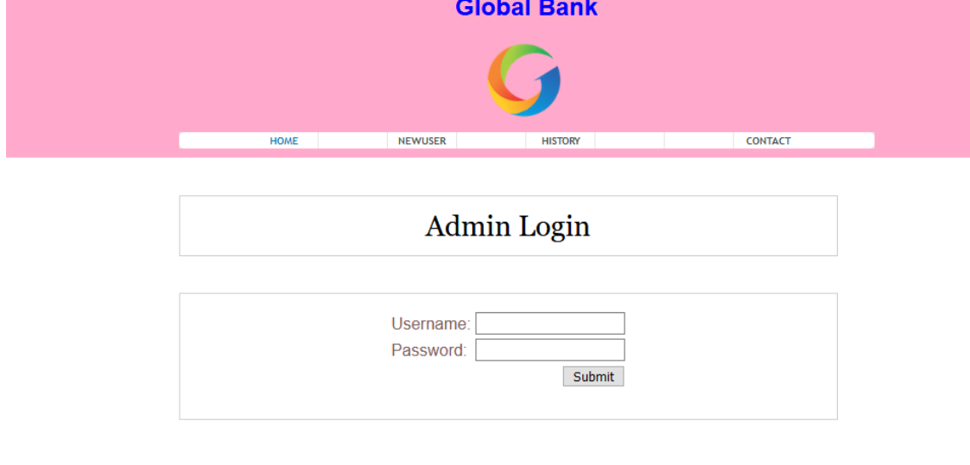
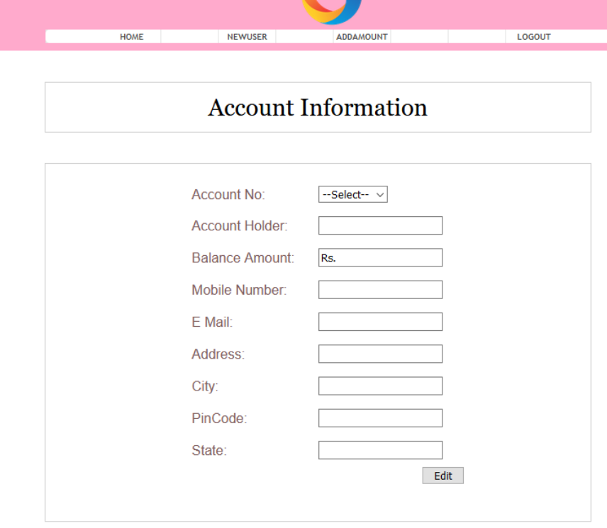
SCREENSHOTS:

Slide 26
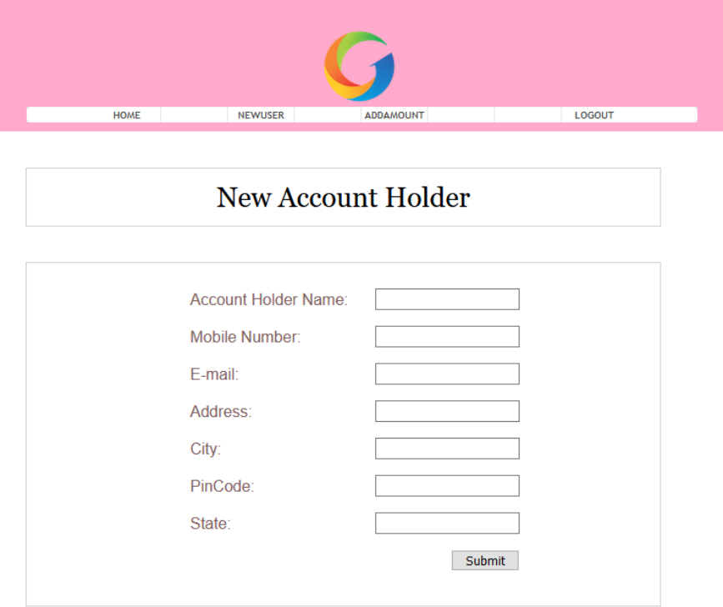
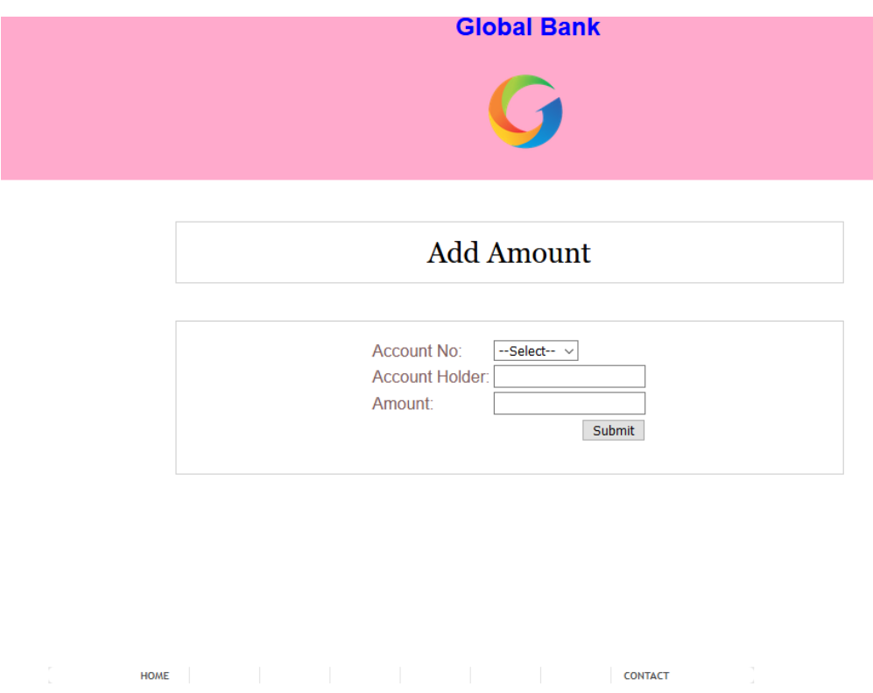

Slide 27
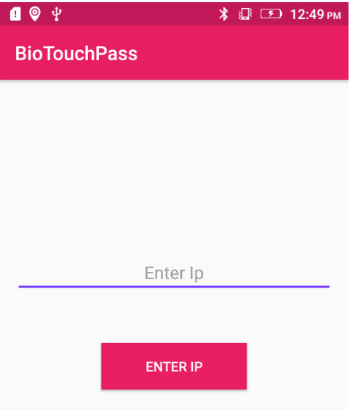
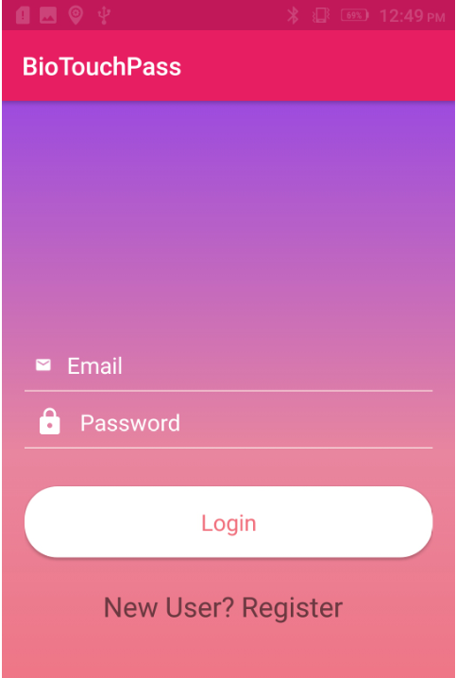

Slide 28
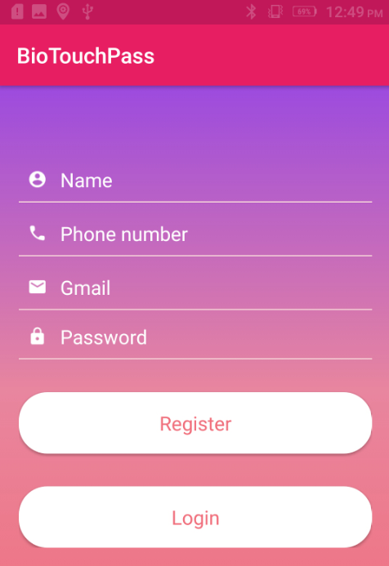
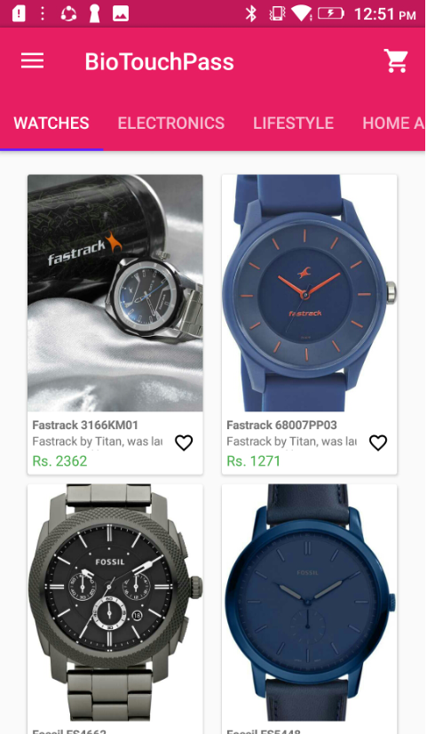

Slide 29
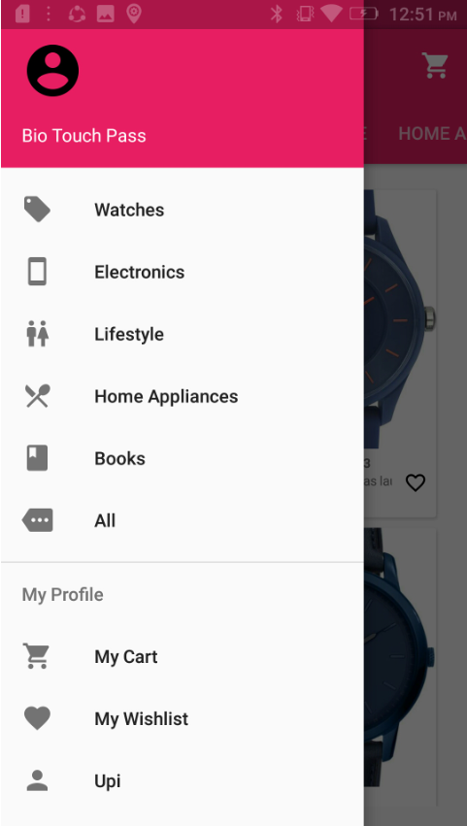
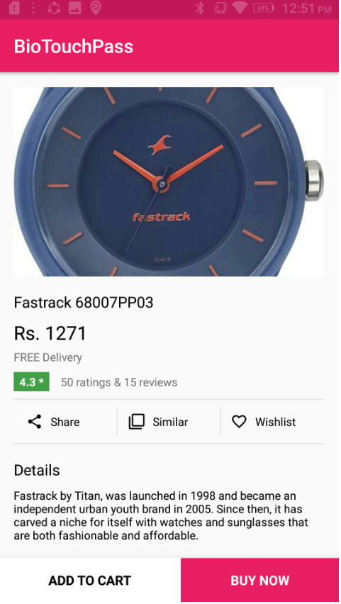

Slide 30
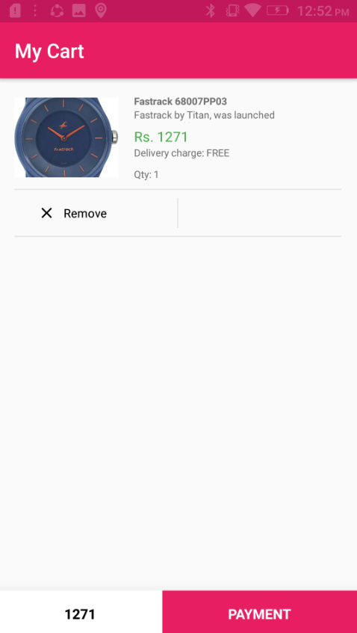
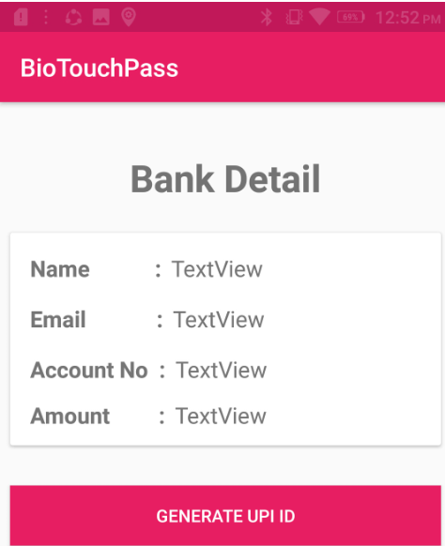

Slide 31
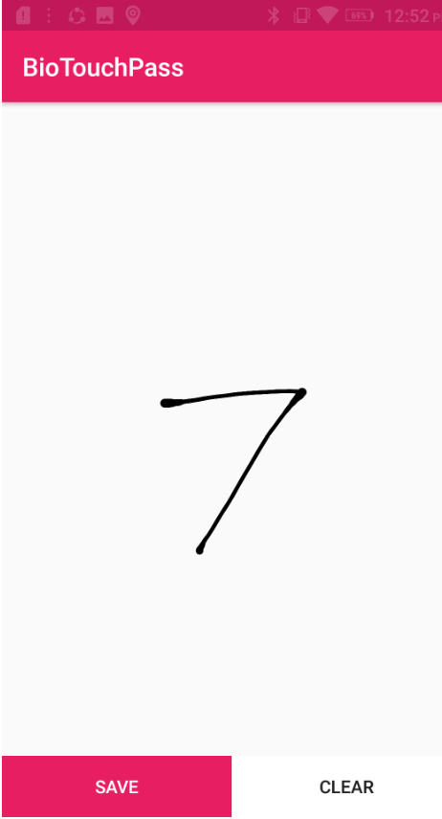
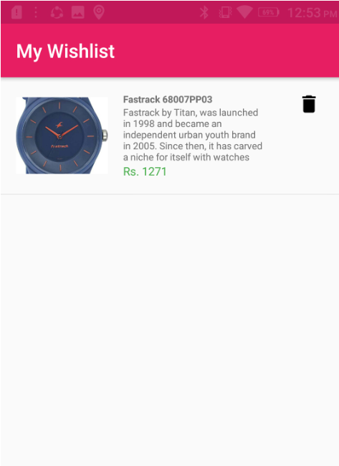

Slide 32
Conclusion:
We propose the smart way to authenticate the social networking accounts belonging to them by using the screen brightness of android mobiles in order to avoid the spyware attack, shoulder surfing attack, and man in the middle attack.

Slide 33
REFERENCE:
M. Martinez-Diaz, J. Fierrez, and J. Galbally, “Graphical Password based User Authentication with Free-Form Doodles,” IEEE Trans. on Human-Machine Systems, vol. 46, no. 4, pp. 607–614, 2016.
T. Kutzner, F. Ye, I. Bonninger, C. Travieso, M. Dutta, and A. Singh, “User Verification Using Safe Handwritten Passwords on Smartphones,” in Proc. 8th International Conference on Contemporary Computing, IC3, 2015.
T. Nguyen, N. Sae-Bae, and N. Memon, “DRAW-A-PIN: Authentication using finger-drawn PIN on touch devices,” Computers and Security, vol. 66, pp. 115–128, 2017.
R. Tolosana, R. Vera-Rodriguez, J. Fierrez, and J. Ortega-Garcia, “Incorporating Touch Biometrics to Mobile One-Time Passwords: Exploration of Digits,” in Proc. IEEE Conference on Computer Vision and Pattern Recognition Workshops, 2018.
——, “Presentation Attacks in Signature Biometrics: Types and Introduction to Attack Detection,” S. Marcel, M.S. Nixon, J. Fierrez and N. Evans (Eds.), Handbook of Biometric Anti-Spoofing (2nd Edition), Springer, 2019.

Slide 34
REFERENCE:
A. Serwadda, V. Phoha, and Z. Wang, “Which Verifiers Work?: A Benchmark Evaluation of Touch-based Authentication Algorithms,” in Proc. of the Int. Conf. on Biometrics: Theory, Applications and Systems, 2013, pp. 1–8.
V. Patel, R. Chellappa, D. Chandra, and B. Barbello, “Continuous User Authentication on Mobile Devices: Recent Progress and Remaining Challenges,” IEEE Signal Processing Magazine, vol. 33, pp. 49–61, 2016.
J. Fierrez and J. Ortega-Garcia, “On-Line Signature Verification,” A.K. Jain, A. Ross and P.Flynn (Eds.), Handbook of Biometrics, Springer, pp. 189–209, 2008.
R. Plamondon and S. Srihari, “On-Line and Off-Line Handwriting Recognition: a Comprehensive Survey,” IEEE Transactions on Pattern Analysis and Machine Intelligence, vol. 22, pp. 63–84, 2000.
R. Plamondon, G. Pirlo and D. Impedovo, “Online Signature Verification,” D. Doermann and K. Tombre (Eds.), Handbook of Document Image Processing and Recognition, Springer, pp. 917–947, 2014.

Slide 35
REFERENCE:
M. Diaz, M. Ferrer, D. Impedovo, M. Malik, G. Pirlo, and R. Plamondon, “A Perspective Analysis of Handwritten Signature Technology,” ACM Computing Surveys, pp. 103–112, 2018.
R. Tolosana, R. Vera-Rodriguez, J. Fierrez, and J. Ortega-Garcia, “Ex ploring Recurrent Neural Networks for On-Line Handwritten Signature Biometrics,” IEEE Access, vol. 6, pp. 5128–5138, 2018.
——, “Improving Accuracy, Applicability and Usability of Keystroke Biometrics on Mobile Touchscreen Devices,” in Proc. of the CHI Conference on Human Factors in Computing Systems, 2015, pp. 1393– 1402.
L. Li, X. Zhao, and G. Xue, “Unobservable Re Authentication for Smartphones,” in Proc. 20th Network and Distributed System Security Symposium, NDSS, 2013.
N. Sae-Bae, N. Memon, K. Isbister, and K. Ahmed, “Multitouch Gesture-Based Authentication,” IEEE Transactions on Information Forensics and Security, vol. 9, no. 4, pp. 568–582, 2014.

